Slide 1
EFB 390 Recitation
Tuesday August 29, 2023

Slide 2
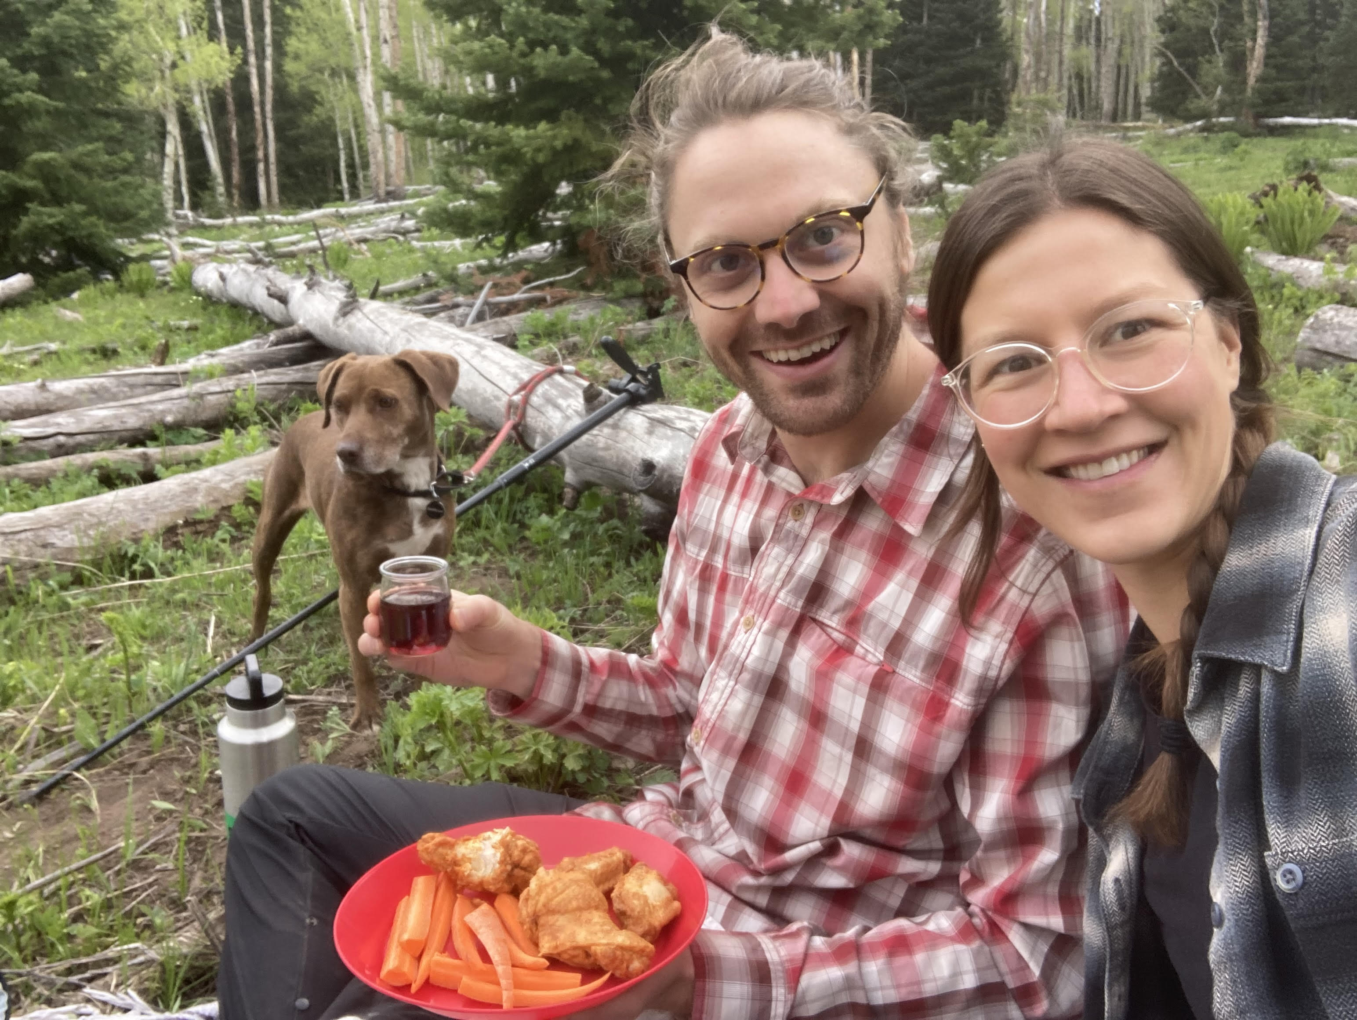
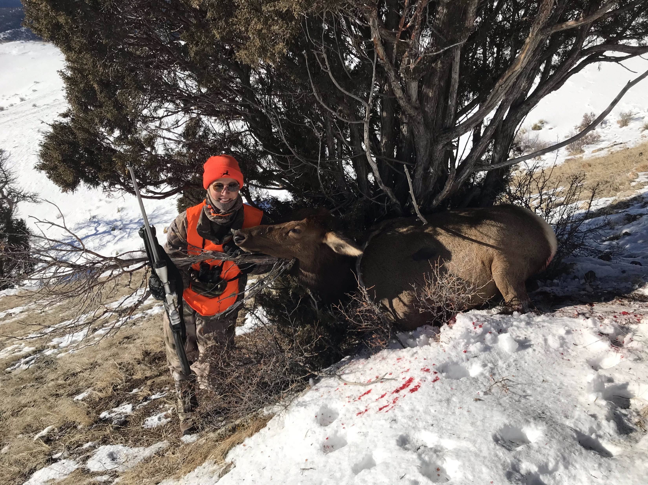
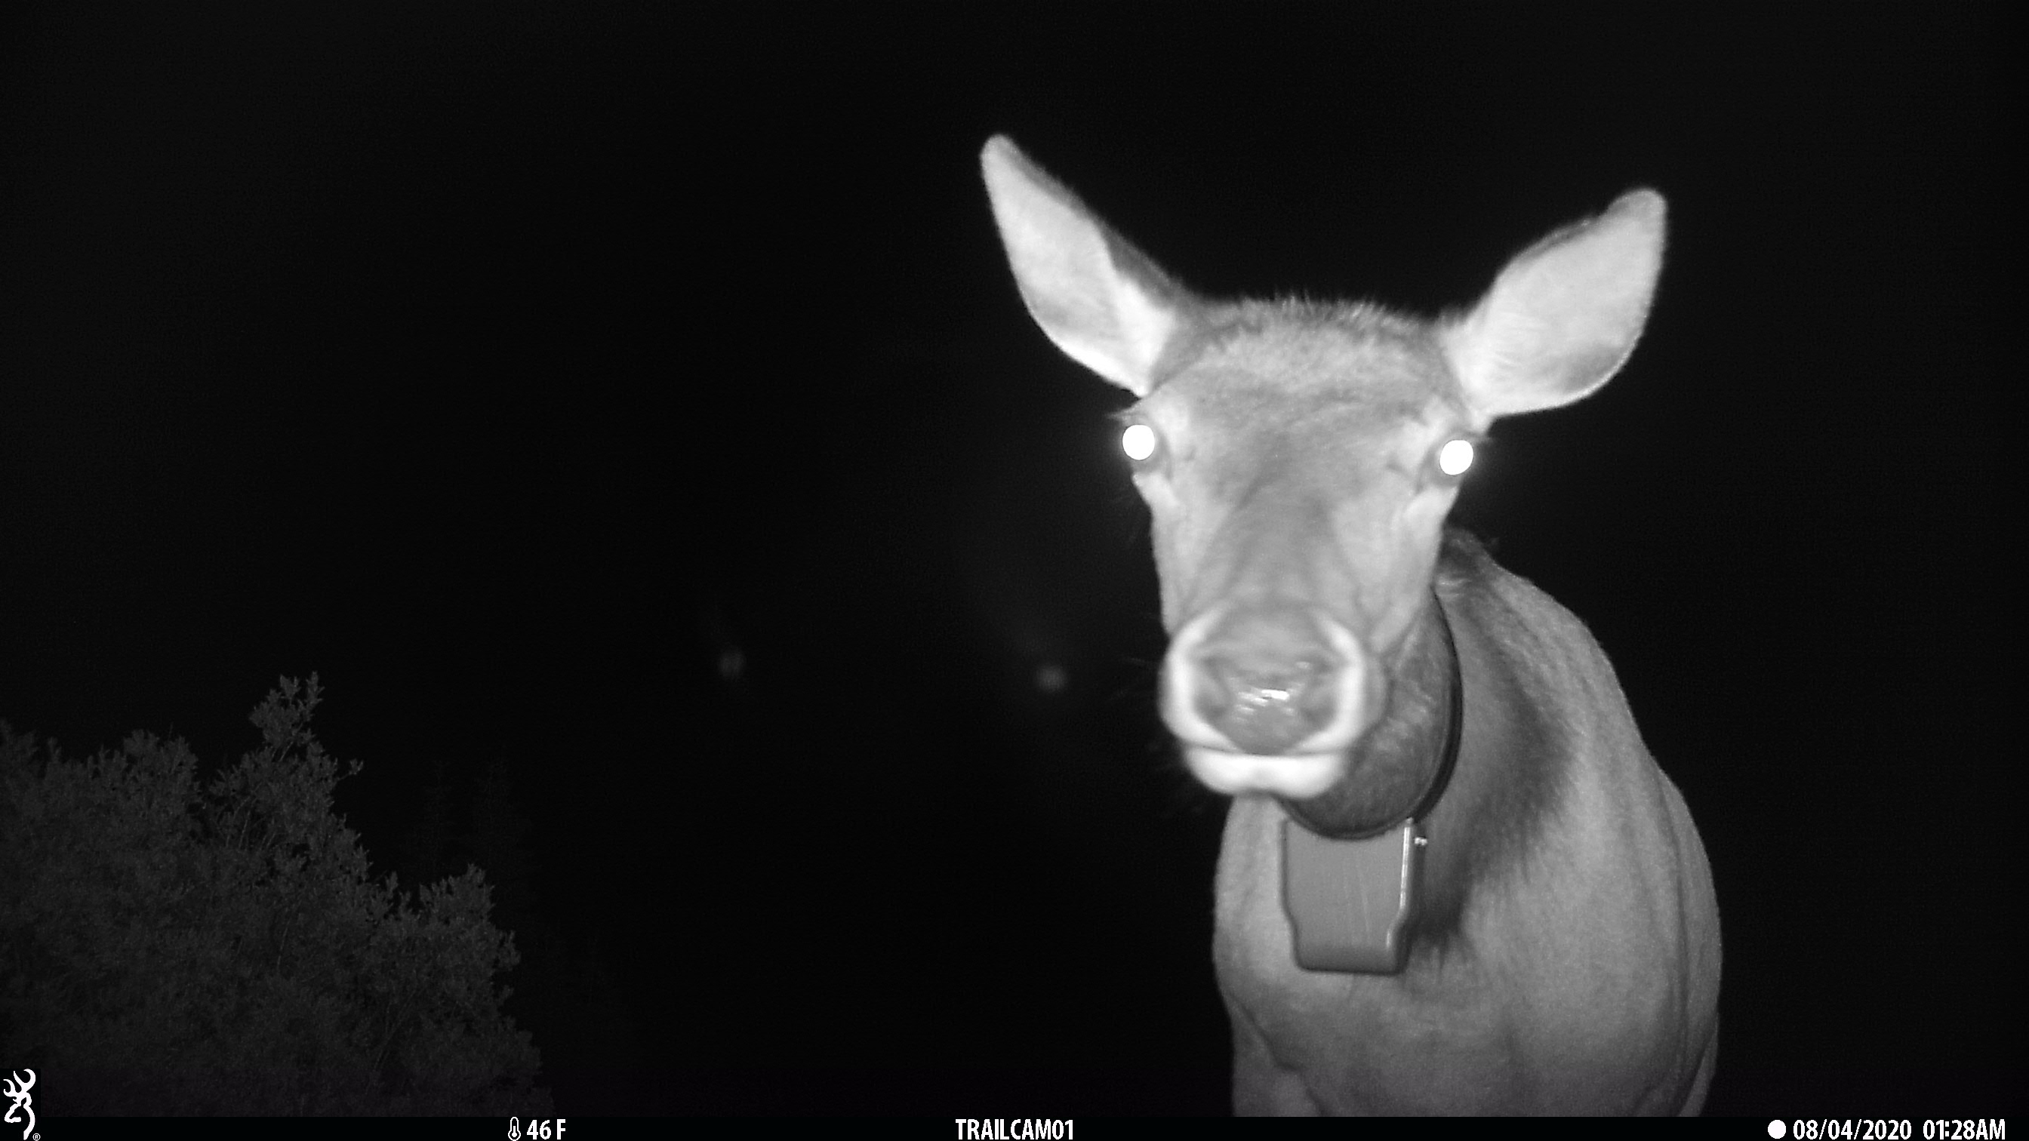
Chloe Beaupre she/her
B.S. Society & Environment - UC Berkeley
Dual masters - Western Colorado University
M.S. in Ecology - Animal Sample Size Guidelines for Mapping Migrations and Distribution with GPS Collars
Master in Environmental Management – Influence of Recreation on Deer and Elk in the Gunnison Basin
PhD – SUNY ESF – caribou survival and movement
Office Hours: Mondays 12-1 pm Illick 244
cbeaupre@esf.edu

Slide 3

Safe Spaces

Slide 4
Recitation sections
From syllabus:
“Lots of readings and discussions”
“Also developing and work-shopping the final projects”
Not recorded (usually)
Today:
Intros
Goals of management discussion
Notes:
This is from the syllabus for what to expect in recitation
I expect you all to be here prepared, having done the readings, ready to be engaged in discussion
We have a loose outline of what we’ll be doing in discussion and I’ll try to send out an email weekly on Monday to recap

Slide 5
Goals of management (Fryxell, Sinclair, Caughley)
A wildlife population may be managed in one of four ways:
Make it increase;
Make it decrease;
Harvest it for continued yield;
Leave it alone but keep an eye on it.
These are the only options available to the manager.
Three decisions are needed:
What is the desired goal?
Which management option is therefore appropriate?
By what action is this best achieved?
The first decision requires a value judgement, the others technical judgments

Slide 6
Case studies
Deer still wreaking havoc in some Syracuse neighborhoods, despite recent culling efforts
Why can’t tourists stop messing with wild animals?
Killing nearly 500 wolves in a year failed to protect endangered caribou – study
‘Rabid Bears’ May Be Roaming Hudson Valley, Parts Of New York State
What are the goals?
Who determines the goals?
Who are the stakeholders?
What information is needed?
What are the outcomes?

Slide 7
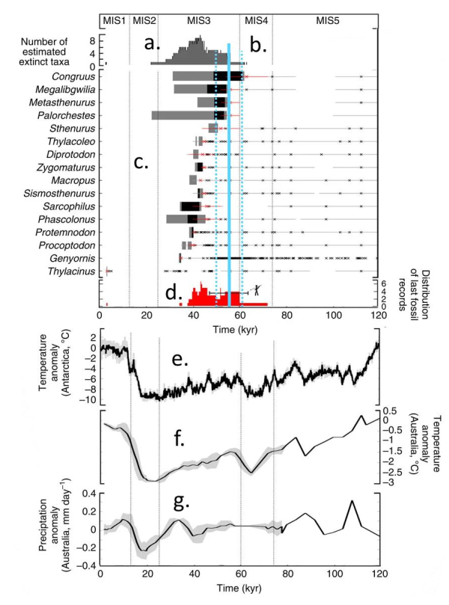
Interpreting figures
Label the caption by filling out the letters (a-g):
“Mean annual temperature anomalies relative to the present day calculated from the Antarctica EPICA Dome C ice core.”
“Precipitation anomalies from HadCM32 palaeoclimate simulations.”
“Frequency distribution of the last observation for all genera.
“Models of extinction time for each taxon.”
“Mean annual temperature anomaly from HadCM3 palaeoclimate simulations.”
“Frequency distribution of extinction times for all megafauna genera.”
“Human arrival – median model consensus (solid line) ± 1 standard deviation (dashed lines).”
Notes:
When did humans arrive in Australia (within 5,000 years)? Provide a point estimate and 95% confidence interval
How would you characterize the climate in Australia now compared to when humans arrived based on the figure above?

Slide 8
Interpreting figures
When did humans arrive in Australia (within 5,000 years)? Provide a point estimate and 95% confidence interval
How would you characterize the climate in Australia now compared to when humans arrived based on the figure above?
Notes:
When did humans arrive in Australia (within 5,000 years)? Provide a point estimate and 95% confidence interval
How would you characterize the climate in Australia now compared to when humans arrived based on the figure above?

